Slide 1

Project Report on Micro Credit Loan Defaulters
By:
Saikrishna Padamatinti

Slide 2
Background & Introduction
A Microfinance Institution (MFI) is an organization that offers financial services to low income populations. Microfinance services (MFS) becomes very useful when targeting especially the unbanked poor families living in remote areas with not much sources of income. The MFS provided by MFI are Group Loans, Agricultural Loans, and Individual Business Loans and so on.
Now a days telecom industries launched various products and have developed its business and organization based on the budget operator model, offering better products at Lower Prices to all value conscious customers through a strategy of disruptive innovation that focuses on the subscriber.
They understand the importance of communication and how it affects a person’s life, thus focusing on providing their services and products to low income families and poor customers that can help them in the need of hour. They are collaborating with an MFI to provide micro-credit on mobile balances to be paid back in some days e.g. in 5/10/15 days.

Slide 3
Business Problem
MFI to provide micro-credit on mobile balances to be paid back in 5 days. The Consumer is believed to be defaulter if he deviates from the path of paying back the loaned amount within the time duration of 5 days.
For the loan amount of 5 (in Indonesian Rupiah), payback amount should be 6 (in Indonesian Rupiah), while, for the loan amount of 10 (in Indonesian Rupiah), the payback amount should be 12 (in Indonesian Rupiah).
The sample data is provided to us from our client database. It is hereby given to you for this exercise. In order to improve the selection of customers for the credit, the client wants some predictions that could help them in further Investment and improvement in selection of customers.
The goal here is to build a model which can be used to predict in terms of a probability for each loan transaction, whether the customer will be paying back the loaned amount within 5 days of insurance of loan. In this case, Label ‘1’ indicates that the loan has been payed i.e. Non- defaulter, while, Label ‘0’ indicates that the loan has not been payed i.e. defaulter.

Slide 4
Approach to Data Cleaning
* First we check the information of the given dataset because it tells that how many rows and columns are present in our dataset and data type of the columns whether they are object, integer or float.
Drop duplicates rows if present in dataset. Then we check for the null values present in our dataset.
If null values are present then fill it via mean, median or mode. Or also you can remove that rows but kindly check it properly.
Here in the given data set there are no null values.
After that we check the summary statistics of our dataset. This part tells about the statistics of our dataset i.e. mean, median, max value ,min values and also it tell whether outliers are present in our dataset or not.

Slide 5
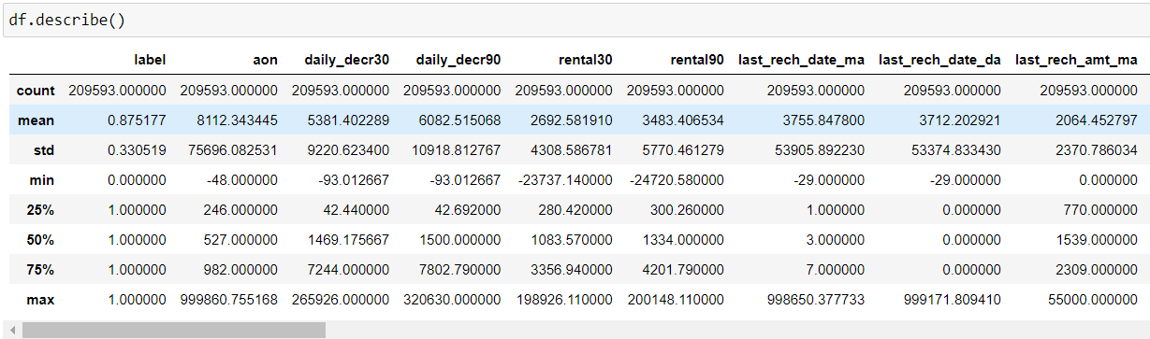
Approach to Data Cleaning (Cntd…)
*Here we have some errors in the dataset. The min value is less than 0 for some features – ‘aon’ ‘daily_decr30’, ‘daily_decr90’, ‘rental30’, ‘rental90’, ‘last_rech_date_ma’, ‘last_rech_date_da’, ‘medianmarechprebal30’, ‘medianmarechprebal90’. So modifying all the negative values to positive values.

Slide 6
Approach to Data Cleaning (Cntd…)
* We also check the correlation of our dataset to check the correlation of the columns with each other. If columns are highly correlated or above then remove those columns to avoid multi coli-nearity problem.
* This can be achieved by looking at the Variance inflation factor of each feature. VIF less than 5 is acceptable, if a feature is having a VIF of more than 5 then that feature should be either transformed or removed.
* After removing features having highest VIF, step by step we have only 24 features left.

Slide 7
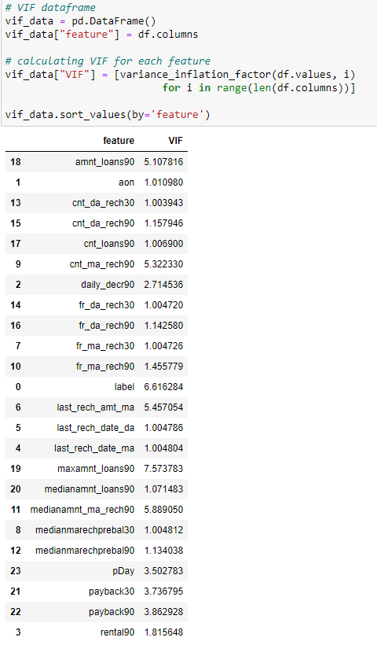

Slide 8
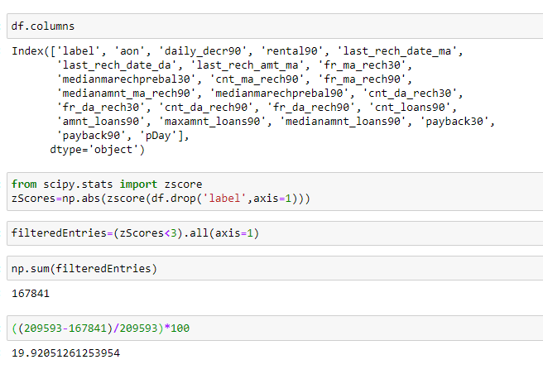
Approach to Data Cleaning (Cntd…)
* We extract data from date column and make new columns like day, month and year to see the outcomes with our target column that is label.
* We delete the pcircle column because it has only one unique value that tells that collected data is only for one circle.
* We remove outliers only if we loose less than 10% of data. And here 20% of data is outliers so not removing them.

Slide 9
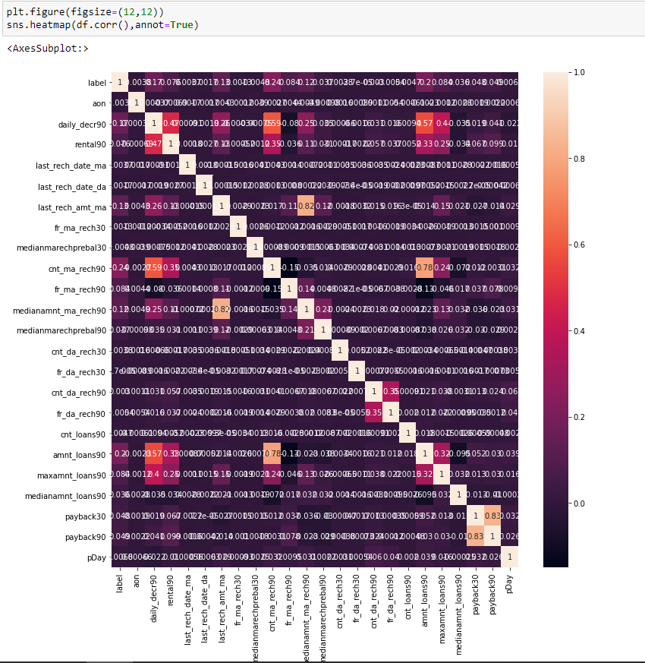
Visualization.
* We plot correlation matrix via heatmap to see the correlation of the columns with other columns.

Slide 10
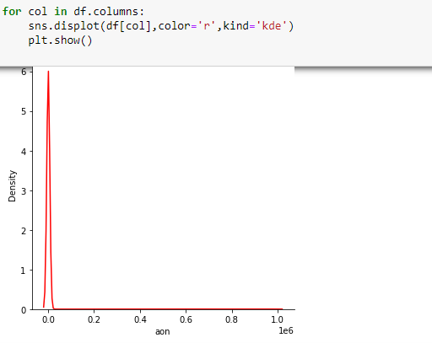
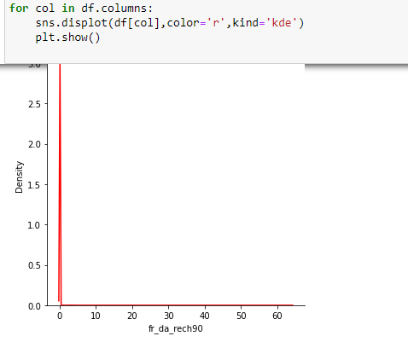
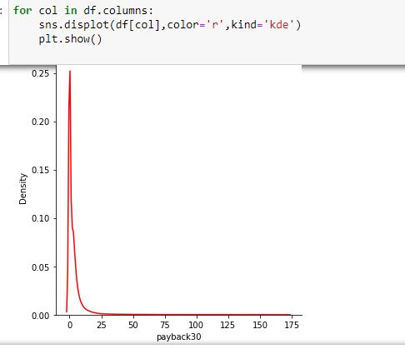
Visualization.
All the features are right skewed.
To remove skewness, boxCox transformation is applied on ‘aon’ and for all other features sqrt transformation is used.

Slide 11
Modelling part
* using train_test_Split, split the data in to train and test part with 33% of test data.
* on checking the value counts for y_train, there is a class imbalance issue. So using SMOTE , for Upsampling the data.
* all the features values are not in the same range so fit standardScaler on the train data and transform the train and test data.
* Train the Decision Tree classifier, AdaBoost classifier and Random Forest classifier on the training data and compared the model accuracy and f1scores on test set.
* Finally choosing RandomForest Classifier as the best model for hyperparameter tuning.
* pipeLine=Pipeline([('smote',SMOTE(random_state=42)), ('scaler',StandardScaler()), ('rfc',RandomForestClassifier())])
param_grid = {'rfc__min_samples_split':[2,3], 'rfc__min_impurity_decrease':[0,0.01], 'rfc__min_samples_leaf':[1,3]}
grid = GridSearchCV(pipeLine,param_grid,verbose=2)

Slide 12
Modelling part
* Based on the best parameters from GridSearchCV creating a Pipeline.
pipeLine=Pipeline([( 'smote’ , SMOTE(random_state=42)),
( 'scaler’ , StandardScaler()),
( 'rfc’, RandomForestClassifier ( min_impurity_decrease = 0, min_samples_leaf = 1 ,
min_samples_split=3))])

Slide 13
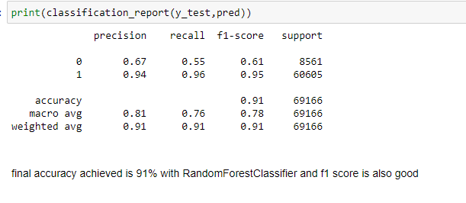
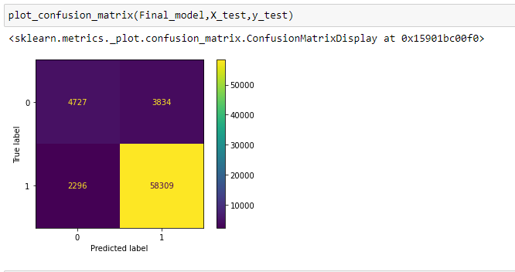
Modelling part

Slide 14
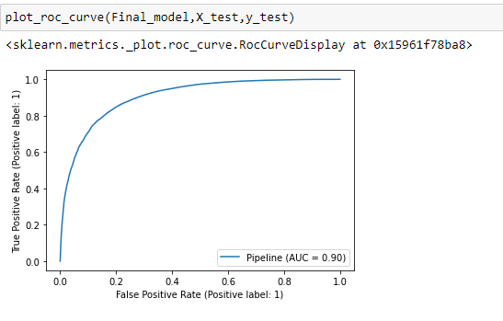
Modelling part

Slide 15
Conclusion
In Conclusion, the Random Forest classifier is chosen as the best model and the accuracy is 91% and the area under AUC_ROC curve is 0.90 which is very good.
As the data is huge, hyperparameter tuning is taking time, so tried with only few parameters. So more parameters can be passed to Grid Search CV to achieve more accuracy.

